Slide 1
Regression Analysis of Death Rate
By Sailee Rumao (MS, Applied Statistics)
Under Dr. Linlin Chen

Slide 2
Data
The death rate is to be represented as a function of :
A1: the average annual precipitation;
A2: the average January temperature;
A3: the average July temperature;
A4: the size of the population older than 65;
A5: the number of members per household;
A6: the number of years of schooling for persons over 22;
A7: the number of households with fully equipped kitchens;
A8: the population per square mile;
A9: the number of office workers;
A10: the number of families with an income less than $3000;
A11: the hydrocarbon pollution index;
A12: the nitric oxide pollution index;
A13: the sulfur dioxide pollution index;
A14: the degree of atmospheric moisture.
B: the death rate.
The model is as follows:
B = A1*X1 + A2*X2 + A3*X3 + A4*X4 + A5*X5 + A6*X6 + A7*X7 + A8*X8 + A9*X9 + A10*X10 + A11*X11 + A12*X12 + A13*X13 + A14*X14 +A15*X15

Slide 3
Data source and References: 1.Richard Gunst, Robert Mason, Regression Analysis and Its Applications: a data-oriented approach 2.Gary McDonald, Richard Schwing Instabilities of regression estimates relating air pollution to mortality. 3. Helmut Spaeth, Mathematical Algorithms for Linear Regression, Academic Press.
There are 60 observations for 14 variables
No Missing data

Slide 4
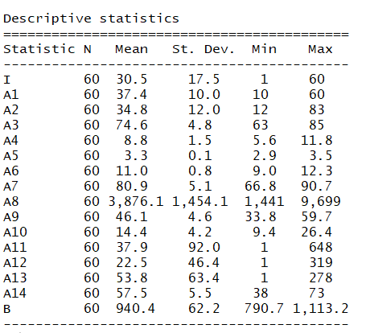

Slide 5
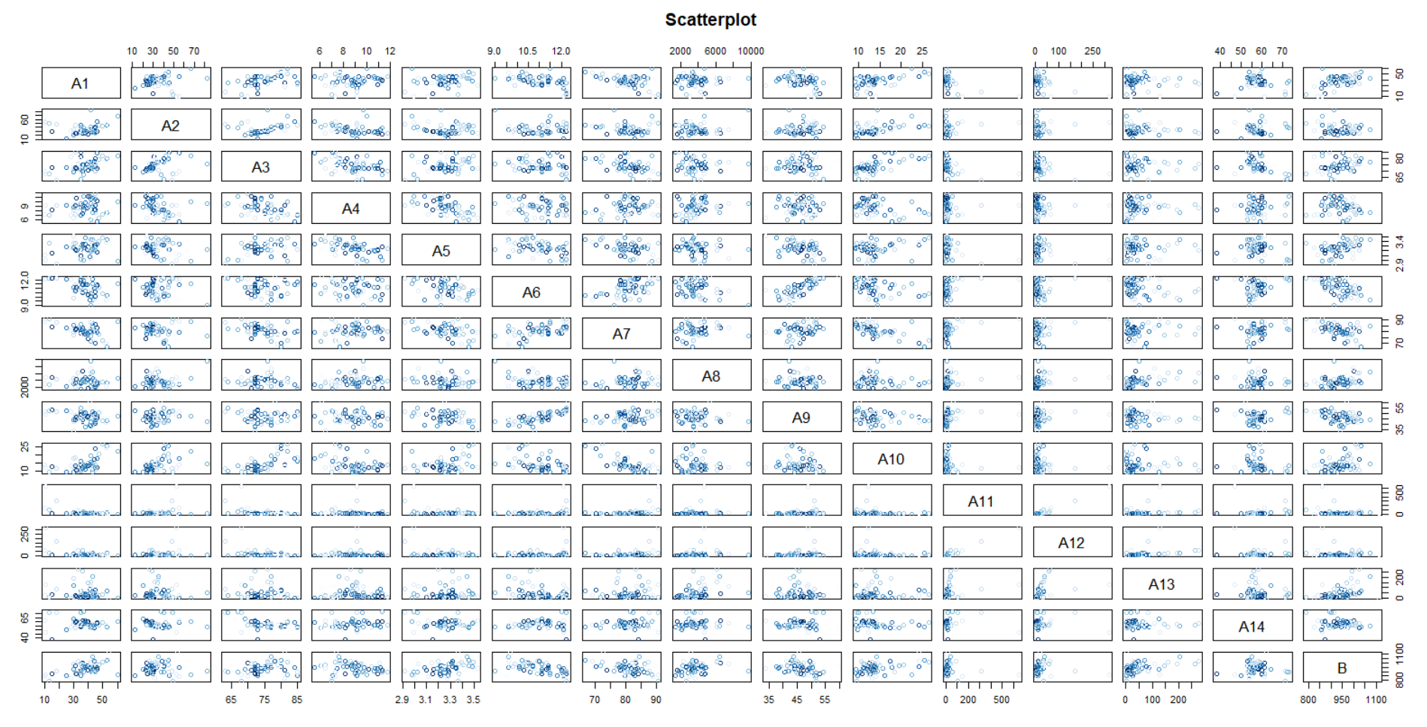
Study of Relationship between Dependent and Independent Variables.

Slide 6
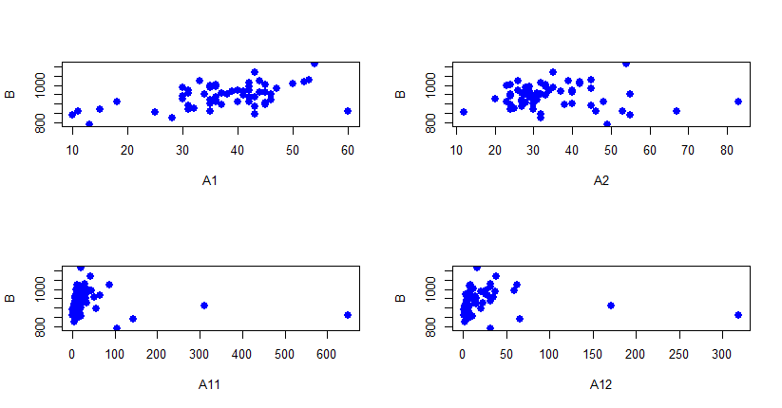

Slide 7
The Fitted Model is: B =1818.708479+ 3.35*A1-2.95466*A2-2.600*A3-27.28804*A4-113.48783*A5- 25.96596*A6-1.14122*A7+ 0.01391*A8+ 1.76738*A9+ 4.21249*A10 - 0.94825*A11+ 2.18534*A12-0.01936*A13+ 1.26610*A14
HYPOTHESIS TESTING OF OVERALL MODEL AND INDIVIDUAL COEFFIECIENTS
THE MODEL IS SIGNIFICANT
A3, A5, A7, A9, A1O, A11, A12, A14 are Insignificant

Slide 8
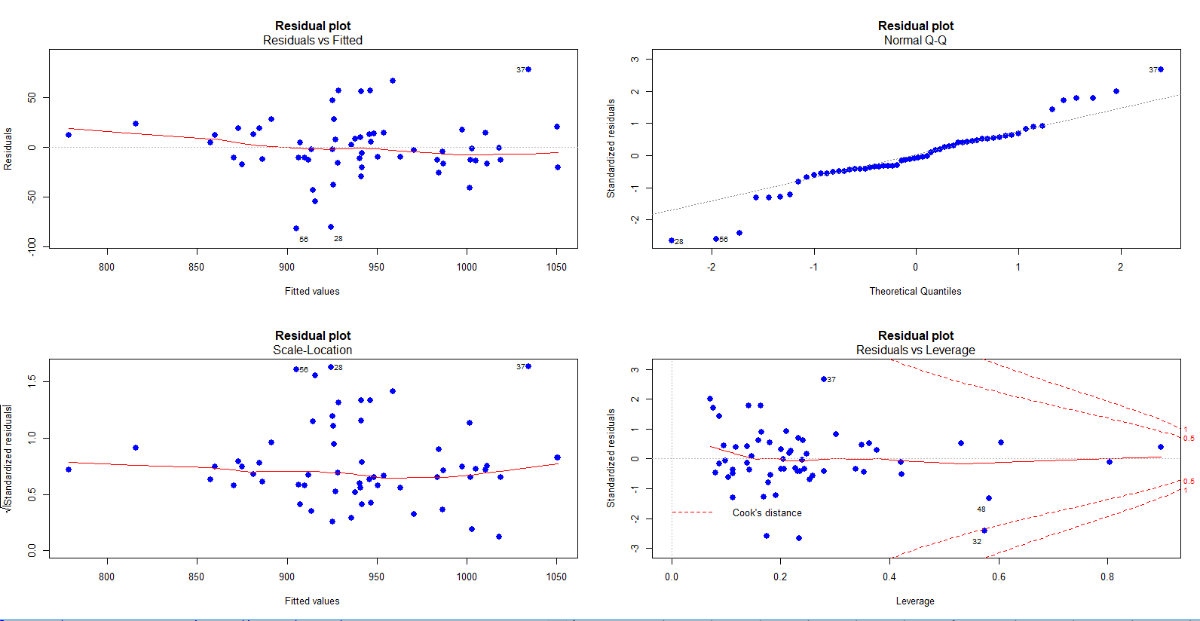
Residual Analysis:

Slide 9

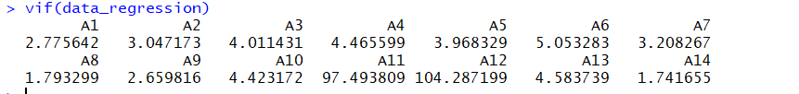
Test for Constant variance Assumption: The assumption of constant variance is satisfied.
To Study Multicollinearity:
Two variables show high multicollinearity.

Slide 10
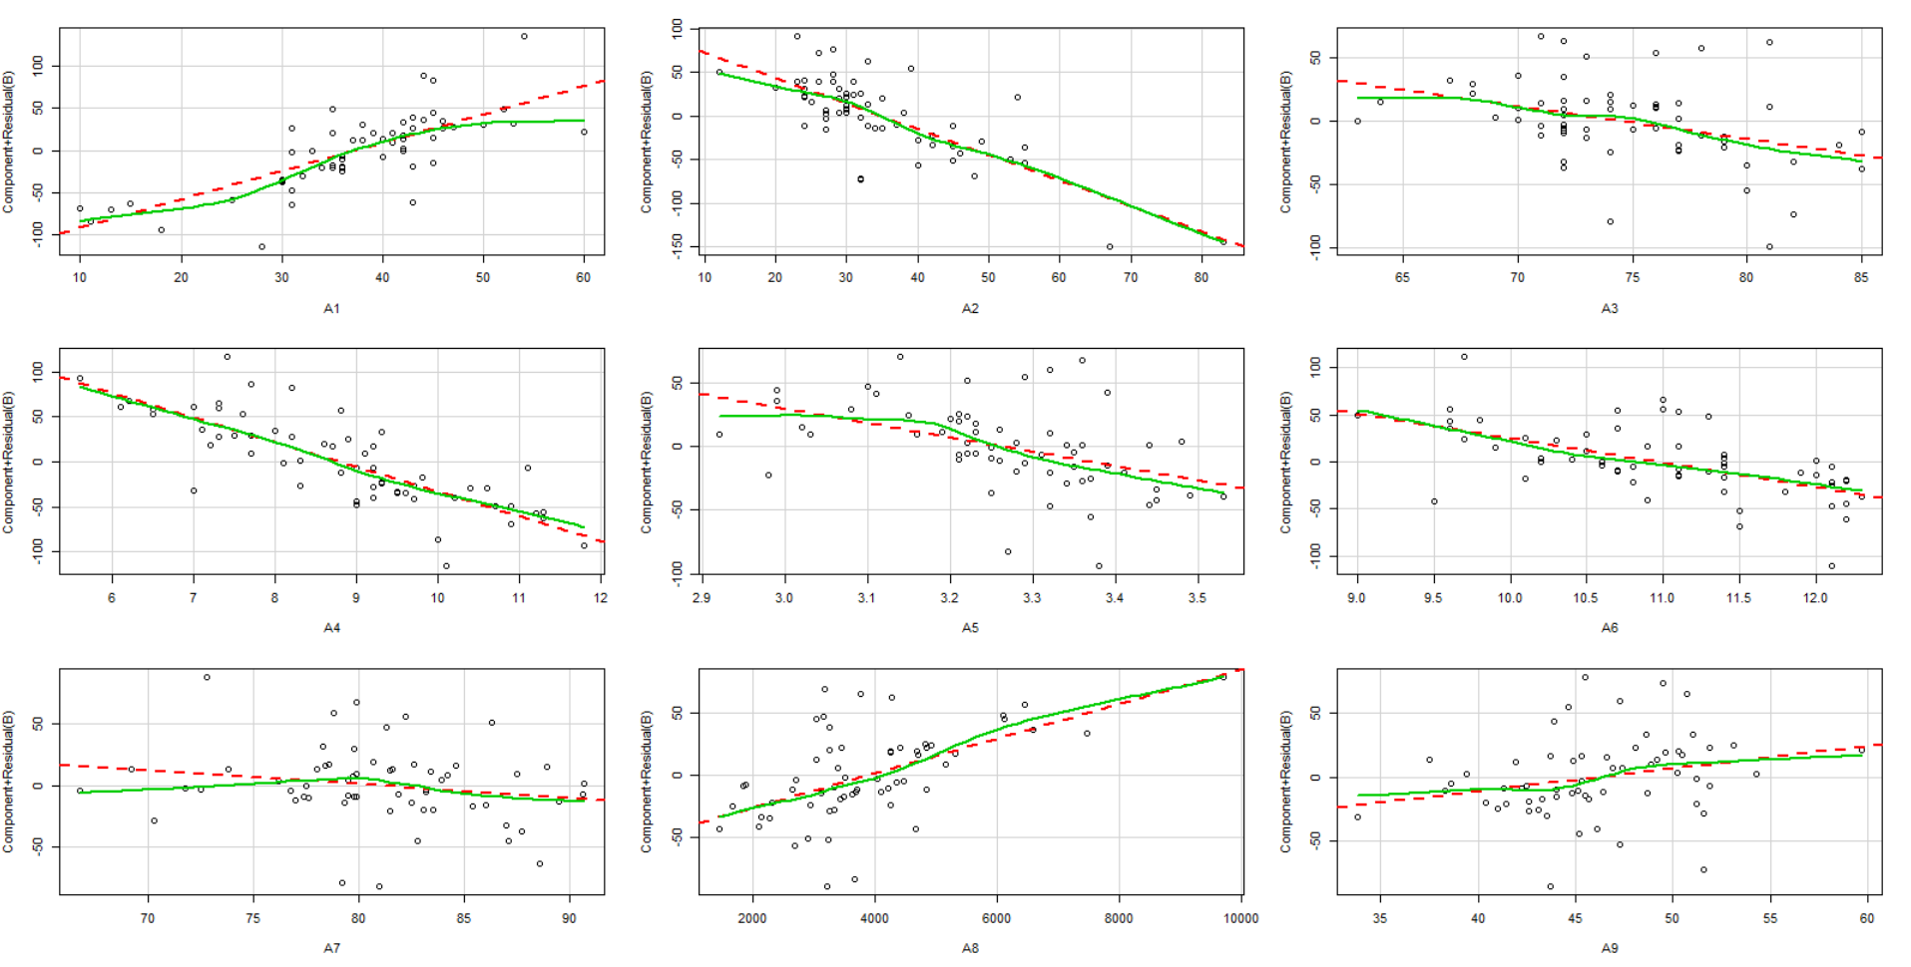
Evaluation of Non-linearity:

Slide 11
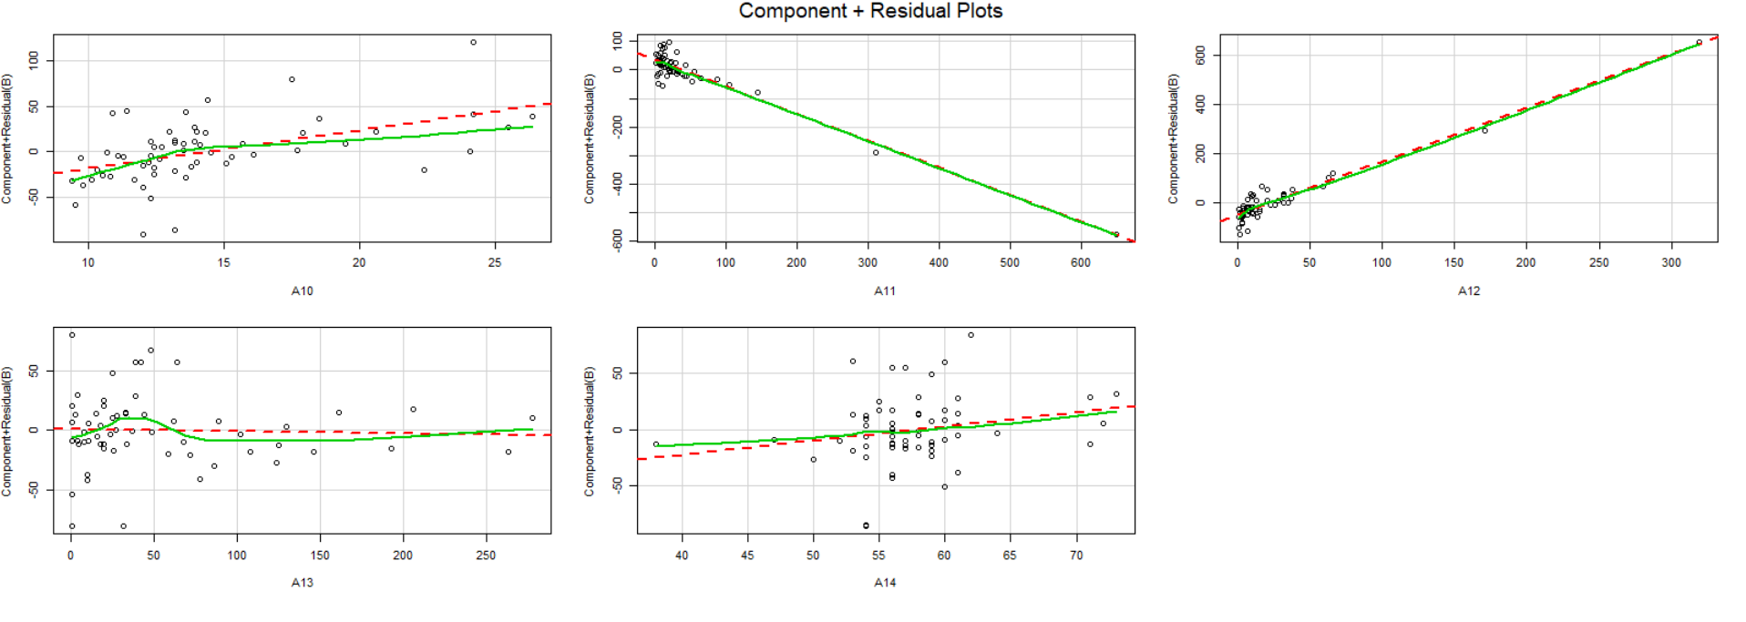

Slide 12
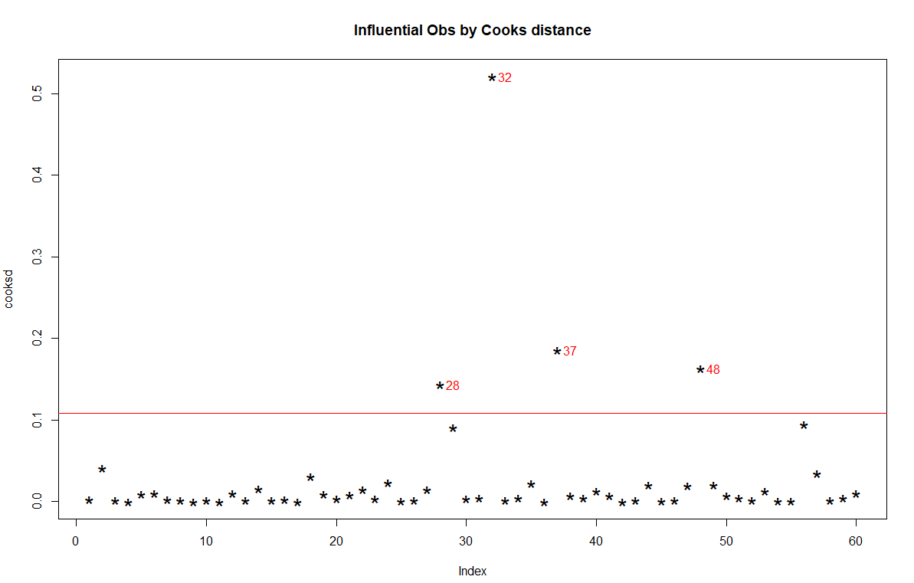

Slide 13

Comparison of Models:

Slide 14
The Model by Backward selection Method is: B=A1*x1+A2*x2+A3*x3+A4*x4+A5*x5+A6*x6+A8*x8+A10*x10+A11*x11+A12*x12+error

Slide 15
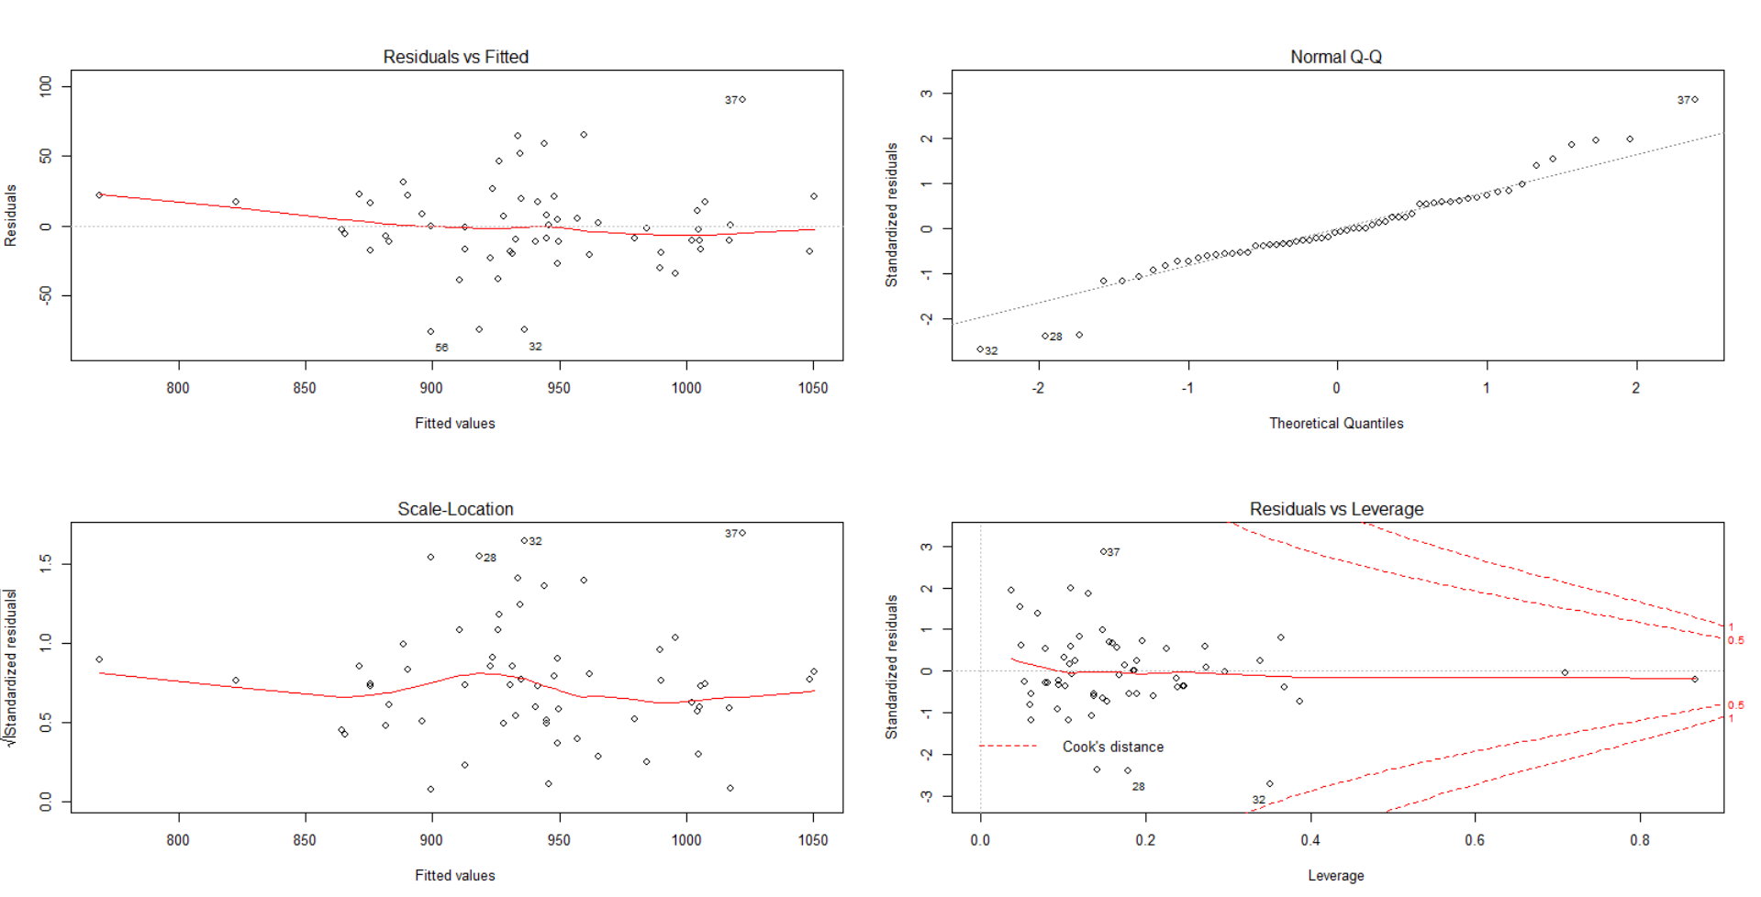
Residual Analysis of Selected Model

Slide 16
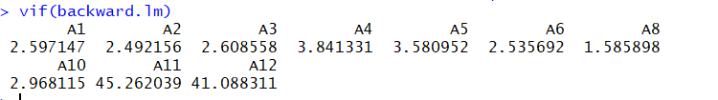
Study of Multicollinearty:

Slide 17
The Model becomes:
B=A1*x1+A2*x2+A3*x3+A4*x4+A5*x5+A6*x6+A8*x8+A10*x10+A12*x12+error
The Overall Model is Significant
Except A3 AND A5,all variables are significant

Slide 18

R_square | Adj_R_Square | AIC | PRESS | MSE
0.802 | 0.7597 | 352.4095 | 43294.52 | 27.19

Slide 19
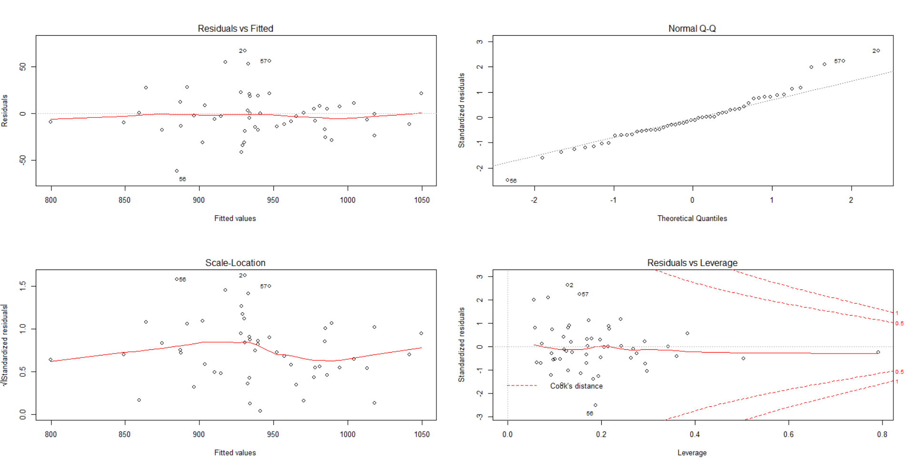

Slide 20
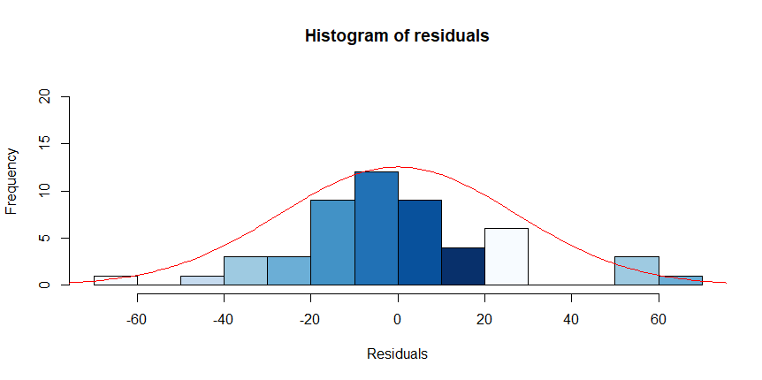

Normality of Residuals
Test for Autocorrelation of Errors
Errors are independently distributed

Slide 21
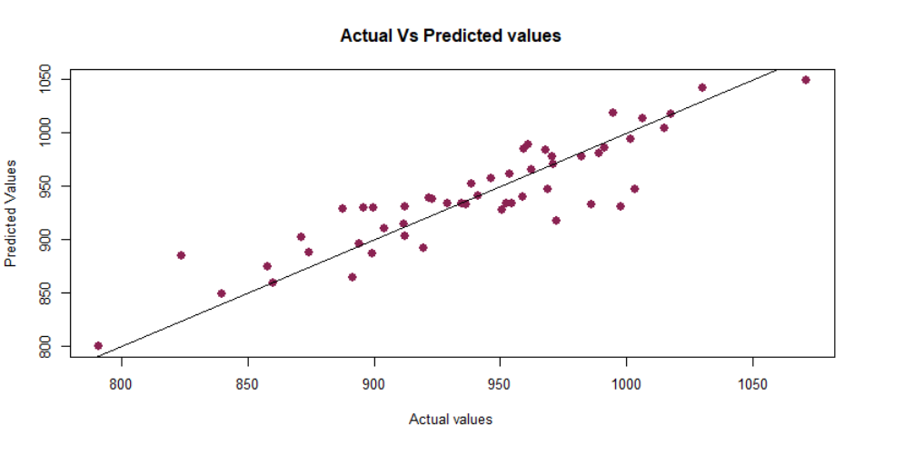

Slide 22
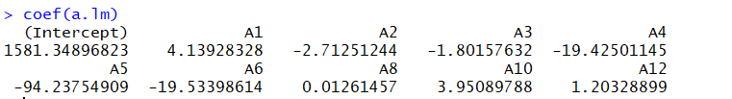
A1: the average annual precipitation;
A2: the average January temperature;
A3: the average July temperature;
A4: the size of the population older than 65;
A5: the number of members per household;
A6: the number of years of schooling for persons over 22;
A7: the number of households with fully equipped kitchens;
A8: the population per square mile;
A9: the number of office workers;
A10: the number of families with an income less than $3000;
A11: the hydrocarbon pollution index;
A12: the nitric oxide pollution index;
A13: the sulfur dioxide pollution index;
A14: the degree of atmospheric moisture.
B: the death rate.

Slide 23
Conclusion & Recommendation
Under hypothetical condition that the coefficients of all variables would be zero the death rate would be high (1581.34897).
The backward selection Model is best suited for Prediction of Mortality rate.
More observations can be used for better and reliable results.

